Slide 1
The Transport Layer

Slide 2
Elements of Transport Protocols (1)
Addressing
Connection establishment
Connection release
Error control and flow control
Multiplexing
Crash recovery

Slide 3
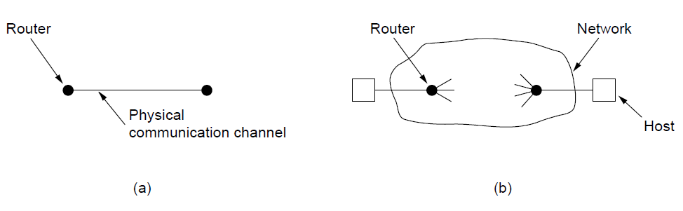
Elements of Transport Protocols (2)
Environment of the data link layer.
Environment of the transport layer.

Slide 4
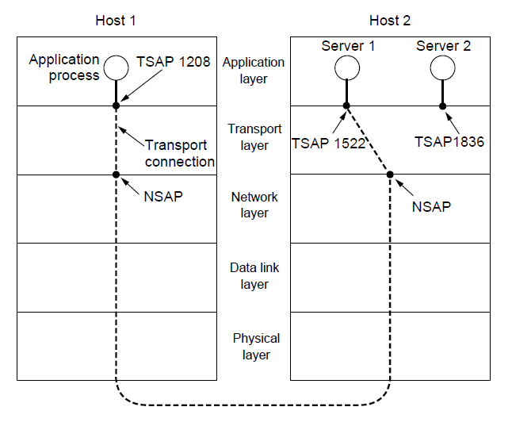
Addressing (1)
TSAPs, NSAPs, and transport connections

Slide 5
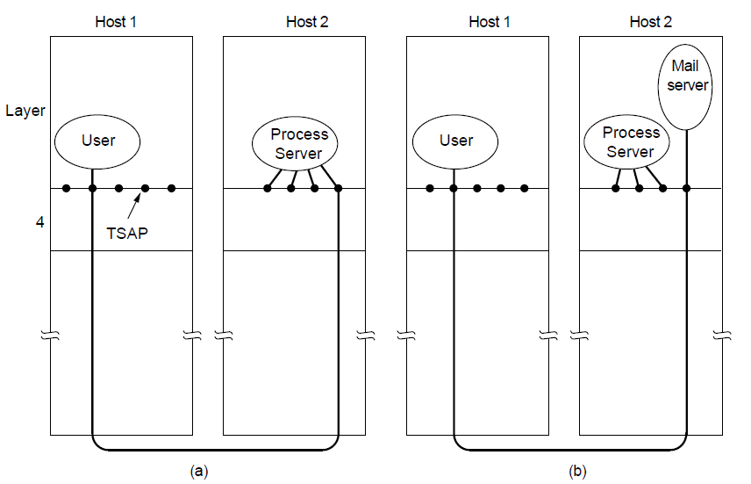
Addressing (2)
How a user process in host 1 establishes a connection
with a mail server in host 2 via a process server.

Slide 6
Connection Establishment (1)
Techniques for restricting packet lifetime
Throwaway transport addresses
Each connection a identifier <Peer transport entity, connection entity>

Slide 7
Connection Establishment (2)
Maintain history problem if crashed
Restricted network design.
Putting a hop counter in each packet.
Timestamping each packet.
Also acknowledgement needs to be erased with time T

Slide 8
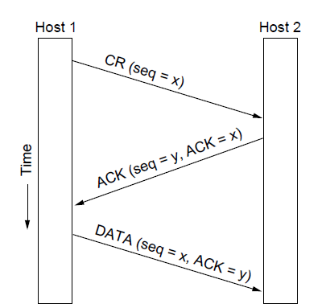
Connection Establishment (3)
Three protocol scenarios for establishing a connection using a
three-way handshake. CR denotes CONNECTION REQUEST. Normal operation.

Slide 9
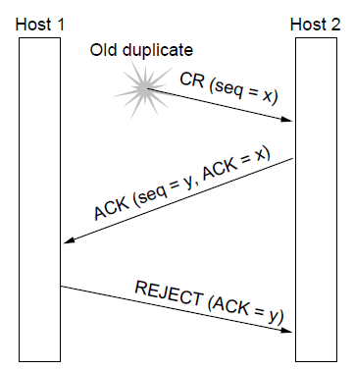
Connection Establishment (4)
Three protocol scenarios for establishing a connection using a
three-way handshake. CR denotes CONNECTION REQUEST. Old duplicate CONNECTION REQUEST appearing out of nowhere.

Slide 10
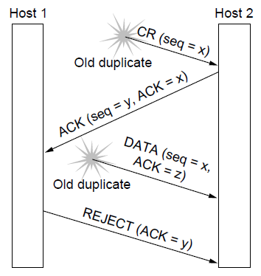
Connection Establishment (5)
Three protocol scenarios for establishing a connection using a
three-way handshake. CR denotes CONNECTION REQUEST. Duplicate CONNECTION REQUEST and duplicate ACK

Slide 11
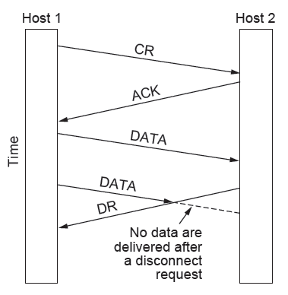
Connection Release (1)
Abrupt disconnection with loss of data – one way release or two way release

Slide 12
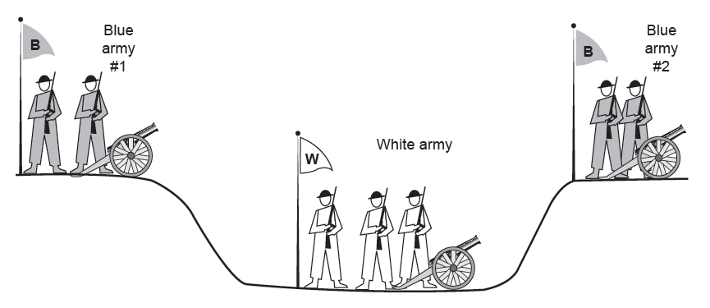
Connection Release (2)
The two-army problem
Synchronize which will go on infinitely

Slide 13
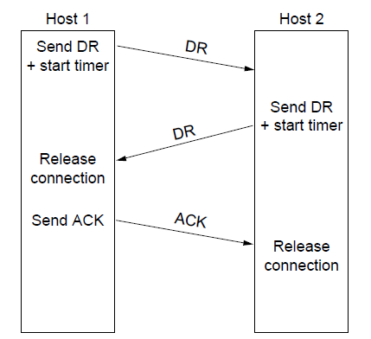
Connection Release (3)
Four protocol scenarios for releasing a connection.
(a) Normal case of three-way handshake

Slide 14
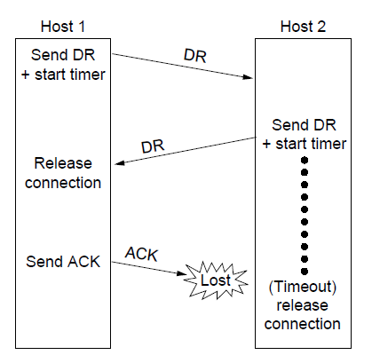
Connection Release (4)
Four protocol scenarios for releasing a connection.
(b) Final ACK lost.

Slide 15
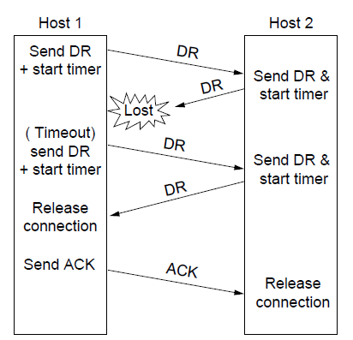
Connection Release (5)
Four protocol scenarios for releasing a connection.
(c) Response lost

Slide 16
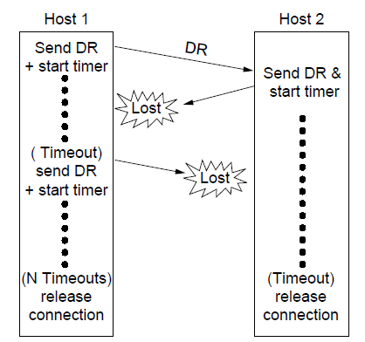
Connection Release (6)
Four protocol scenarios for releasing a connection.
(d) Response lost and subsequent DRs lost.

Slide 17
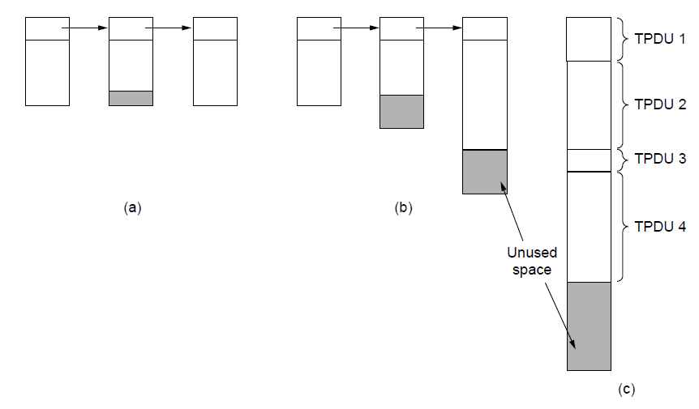
Error Control and Flow Control (1)
(a) Chained fixed-size buffers. (b) Chained variable-sized buffers. (c) One large circular buffer per connection.

Slide 18
For low-bandwidth bursty traffic, it is better not allot buffer but dynamically allot buffer
Decouple sliding window protoco;

Slide 19
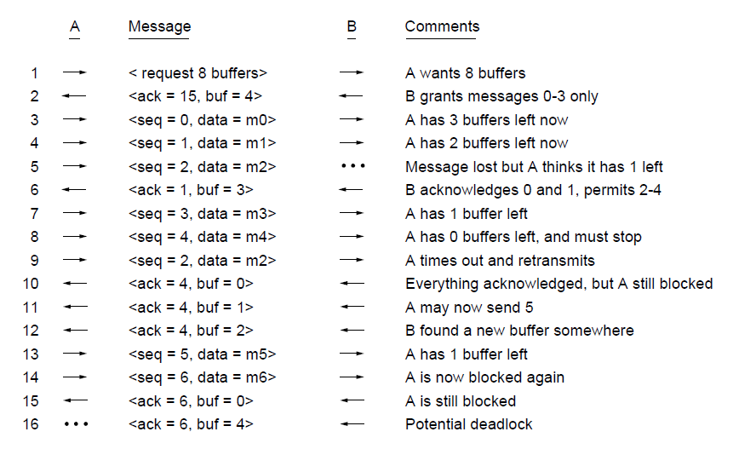
Error Control and Flow Control (2)
Dynamic buffer allocation. The arrows show the direction of transmission. An ellipsis (...) indicates a lost TPDU

Slide 20
Infinite size buffer – k disjoint paths, x packets/sec
If the network can handle c TPDU/sec, cycle time – r then total = cr

Slide 21
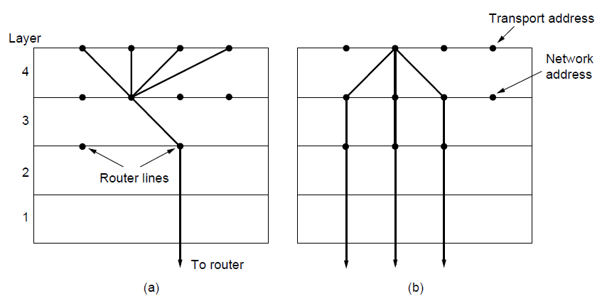
Multiplexing
(a) Multiplexing. (b) Inverse multiplexing.

Slide 22
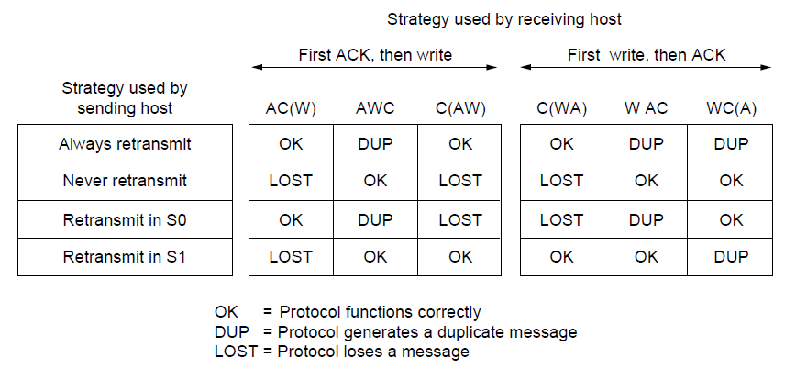
Crash Recovery
Different combinations of client and server strategy

Slide 23
The Internet Transport Protocols: TCP (1)
Introduction to TCP
The TCP service model
The TCP protocol
The TCP segment header
TCP connection establishment
TCP connection release

Slide 24
The Internet Transport Protocols: TCP (2)
TCP connection management modeling
TCP sliding window
TCP timer management
TCP congestion control
TCP futures

Slide 25
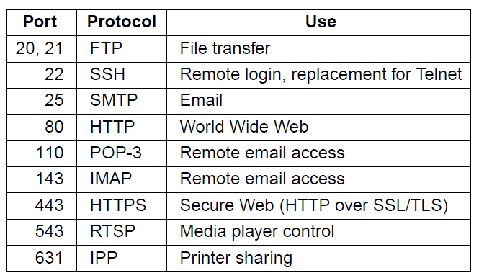
The TCP Service Model (1)
Some assigned ports
Internet Daemon (inetd) attach itself to multiple ports and wait for the first connection request, then fork to that service

Slide 26
All TCP connections are full duplex and point-to-point
Each connection has exactly two ends
TCP doesn’t support multicasting or broadcasting.

Slide 27
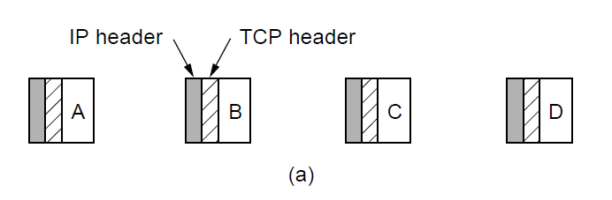
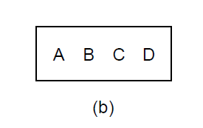
The TCP Service Model (2)
The TCP is byte-stream and not a message-stream, so messages are not differentiated.
Four 512-byte segments sent as separate IP diagrams
The 2048 bytes of data delivered to the application in a single READ call

Slide 28
The TCP Service Model (2)
To force data out -- PUSH flag
Too many PUSH-es then all PUSH are collected together and sent.
URGENT – on pushing Ctrl-C to break-off remote computation, the sending application puts some control flag

Slide 29
TCP Header
TCP segment – 20 byte IP header, 20 –byte TCP header, total 65,535 = 64 KB

Slide 30
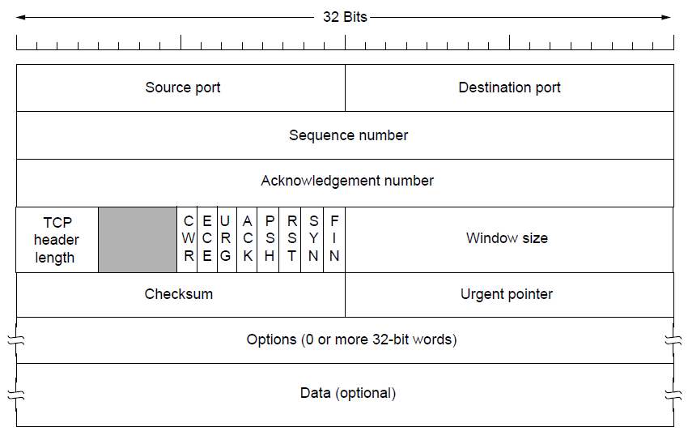
The TCP Segment Header
Ack no = one more – what is next expected
TCP Header – how many optional field
CWR/ECE – Congestion controlling bits (ECE – Echo, CWR – Congestion window reduced)
URG – Urgent, (URGENT POINTER – OFFSET) ACK – Acknowledgement, PSH – Pushed RST – reset, SYN = 1 (CONNECTION REQUEST, CONNECTION ACEEPTED), ACK =0 (REQUEST) ACK = 1(ACCEPT)
WINDOW SIZE = HOW MANY BUFFERS MAY BE GRANTED, CAN BE ZERO

Slide 31
The TCP Segment Header
CHECK SUM – IP ADDR + TCP HEADER + DATA,
ADD ALL THE 16 BITS WORD IN ONES COMPLEMENT AND THEN TAKE ONE’ COMPLEMENT OF THE SUM
ON ADD WITH CHECKSUM – SUMMATION WOULD BE ZERO
CROSS LAYER

Slide 32
The TCP Segment Header
INSTEAD OF GO-BACK-N, HAVE NAKS

Slide 33
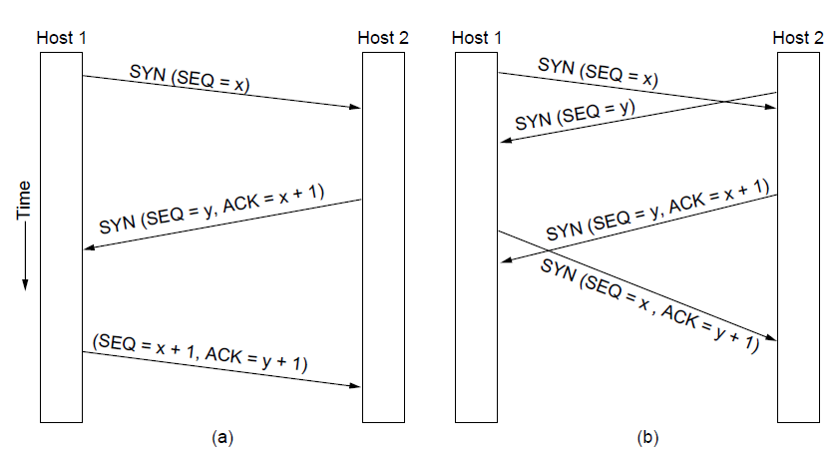
TCP Connection Establishment
TCP connection establishment in the normal case.
Simultaneous connection establishment on both sides.

Slide 34
TCP Connection Release
Either party send with the FIN bit set
When the FIN is acknowledged, that direction is shut down for new data
Full closing (TWO FIN and TWO ACK)

Slide 35
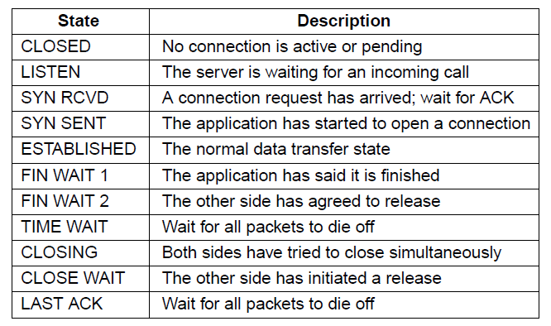
TCP Connection Management Modeling (1)
The states used in the TCP connection
management finite state machine.

Slide 36
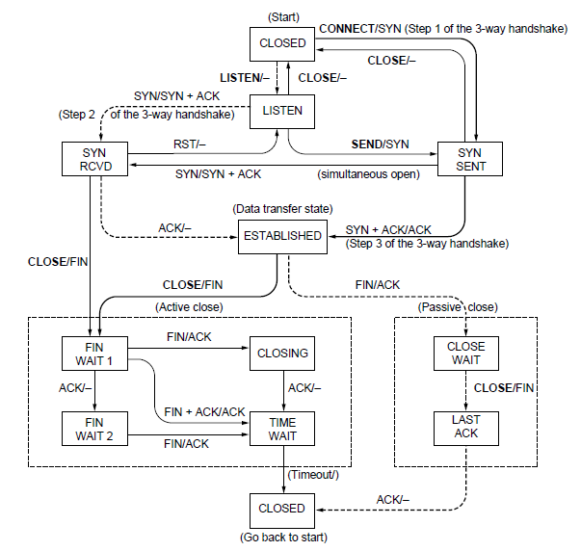
TCP Connection Management Modeling (2)
TCP connection management finite state machine.
The heavy solid line is the normal path for a client. The heavy dashed line is the normal path for a server. The light lines are unusual events. Each transition is labeled by the event causing it and the action resulting from it, separated by a slash.

Slide 37
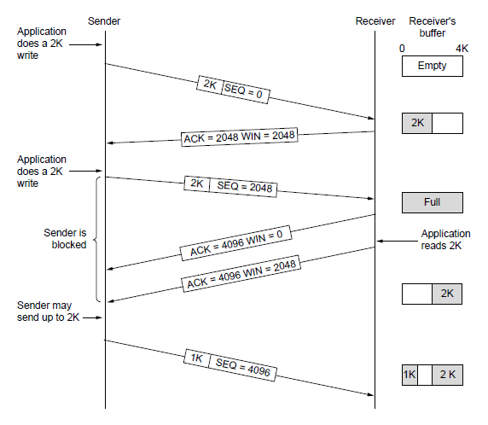
TCP Sliding Window (1)
Window management in TCP
When send – with ) window size – a). Urgent bytes and b). 1- byte to make the receiver to reannounce the next byte expected

Slide 38
Nagle’s Algorithm
Interactive Editor --- Sending 1-byte would involve 162 bytes (40 to send, 40 to ACK, 41 to update, 40 to ack)
Nagle’s Algorithm – When data comes into the sender one byte at a time, just send the first byte and buffer the rest until the outstanding byte is acknowledged

Slide 39
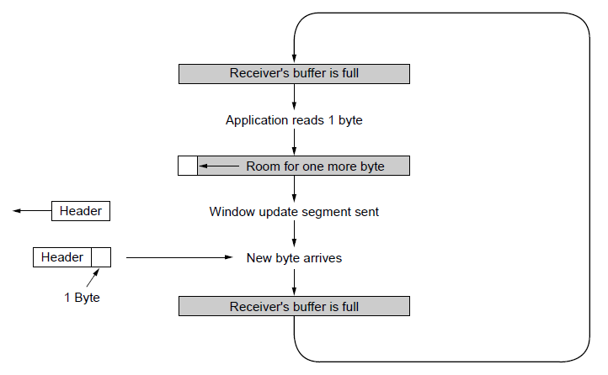
TCP Sliding Window (2)
Silly window syndrome … Clark’s solution – prevent receiver from sending a window update for 1 byte.
Specifically the receiver should not send a window update until it get the maximum segement advertised free

Slide 40
Receiver – Block READ from the application until a large chunk of data arrives
Out of order – 0, 1,2,4,5,6,7

Slide 41
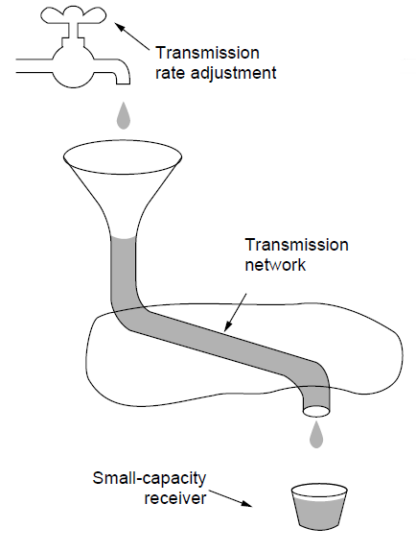
TCP Congestion Control -- Regulating the Sending Rate (1)
A fast network feeding a low-capacity receiver

Slide 42
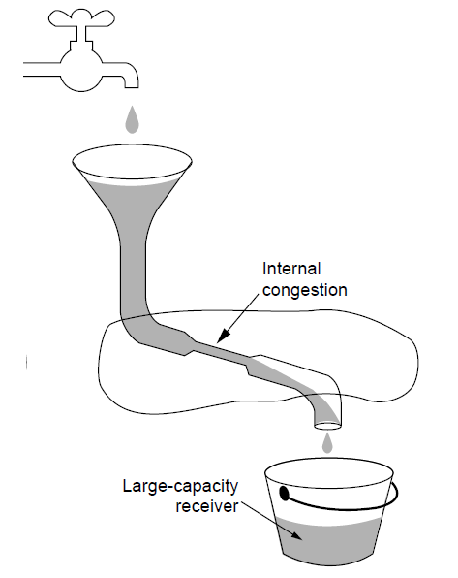
Regulating the Sending Rate (2)
A slow network feeding a high-capacity receiver

Slide 43
TCP Congestion Control
Two windows – the window a receiver window grants
Congestion window
Slow start – 1024 byte - move exponentially – SLOW START
Set threshold – grow linearly after that

Slide 44
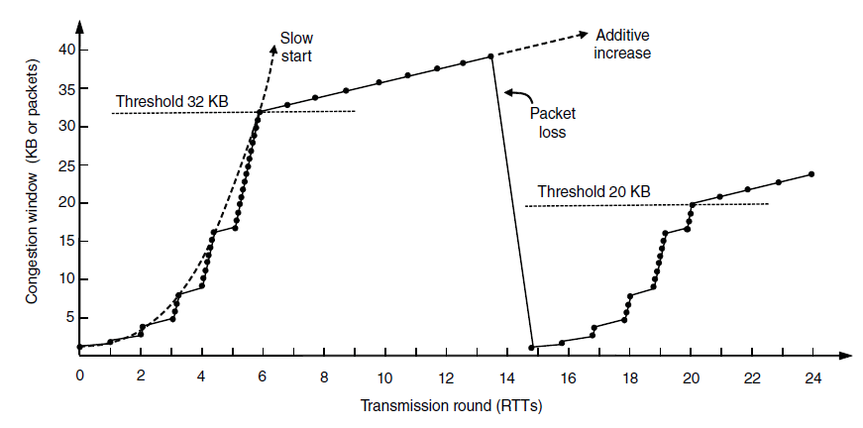
TCP Congestion Control (3)
Slow start followed by additive increase in TCP Tahoe.

Slide 45
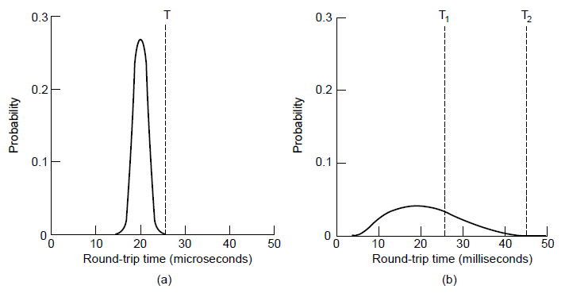
TCP Timer Management
(a). Retransmission timer
Probability density of acknowledgment arrival times in data link layer. (b) … for TCP

Slide 46
Retransmission Timer
RTT = \alpha RTT + (1- \alpha) M
Time-out = \beta . RTT
D = \alpha . D + (1 - \alpha) |RTT – M|
Timeout = RTT + 4 x D

Slide 47
Retransmission Timer
Karn’s algorithm – In dynamic estimation of RTT when a segment times out and is resend.
It is not clear whether the acknowledgement is from the original or resend.
SO don’t include resend packets RTT into calculation.
Each time failure double Time-out time

Slide 48
End

